Slide 1
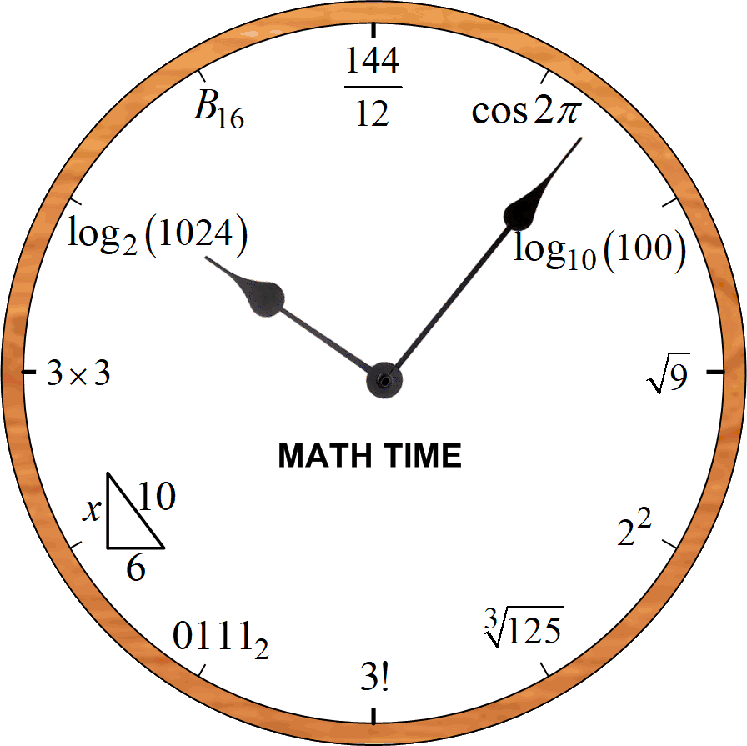

Don Snyder
SLWG 15 Aug 2019

Slide 2
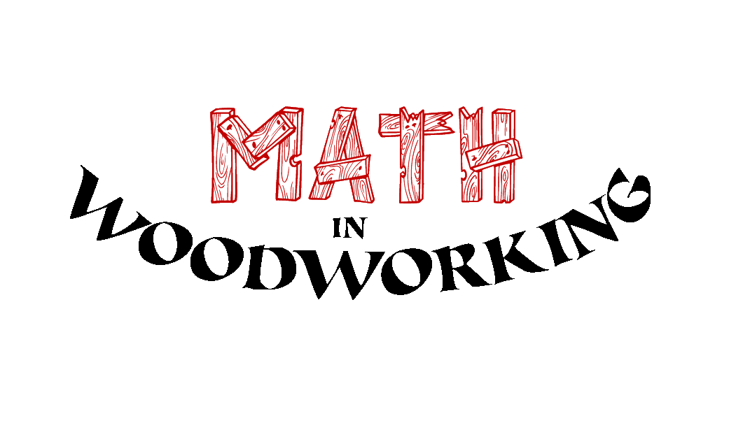

Slide 3







MATH
some like it
& some don’t

Slide 4
some Math-in-Woodworking notes
making polygons on a table saw
compound-angle joinery
cow-catcher design
spiral shapes in woodworking
calculus meets line inlay
lotus flower in a decagon

Slide 5
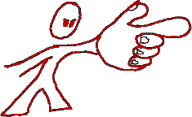
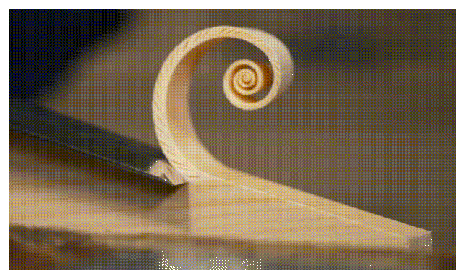
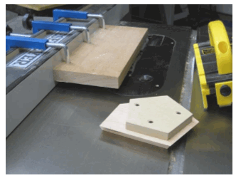
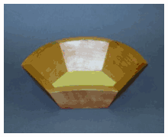
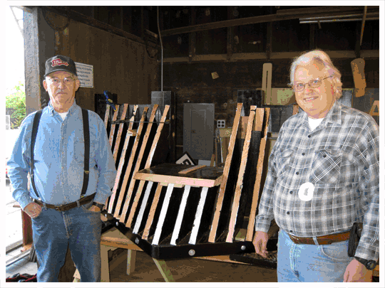
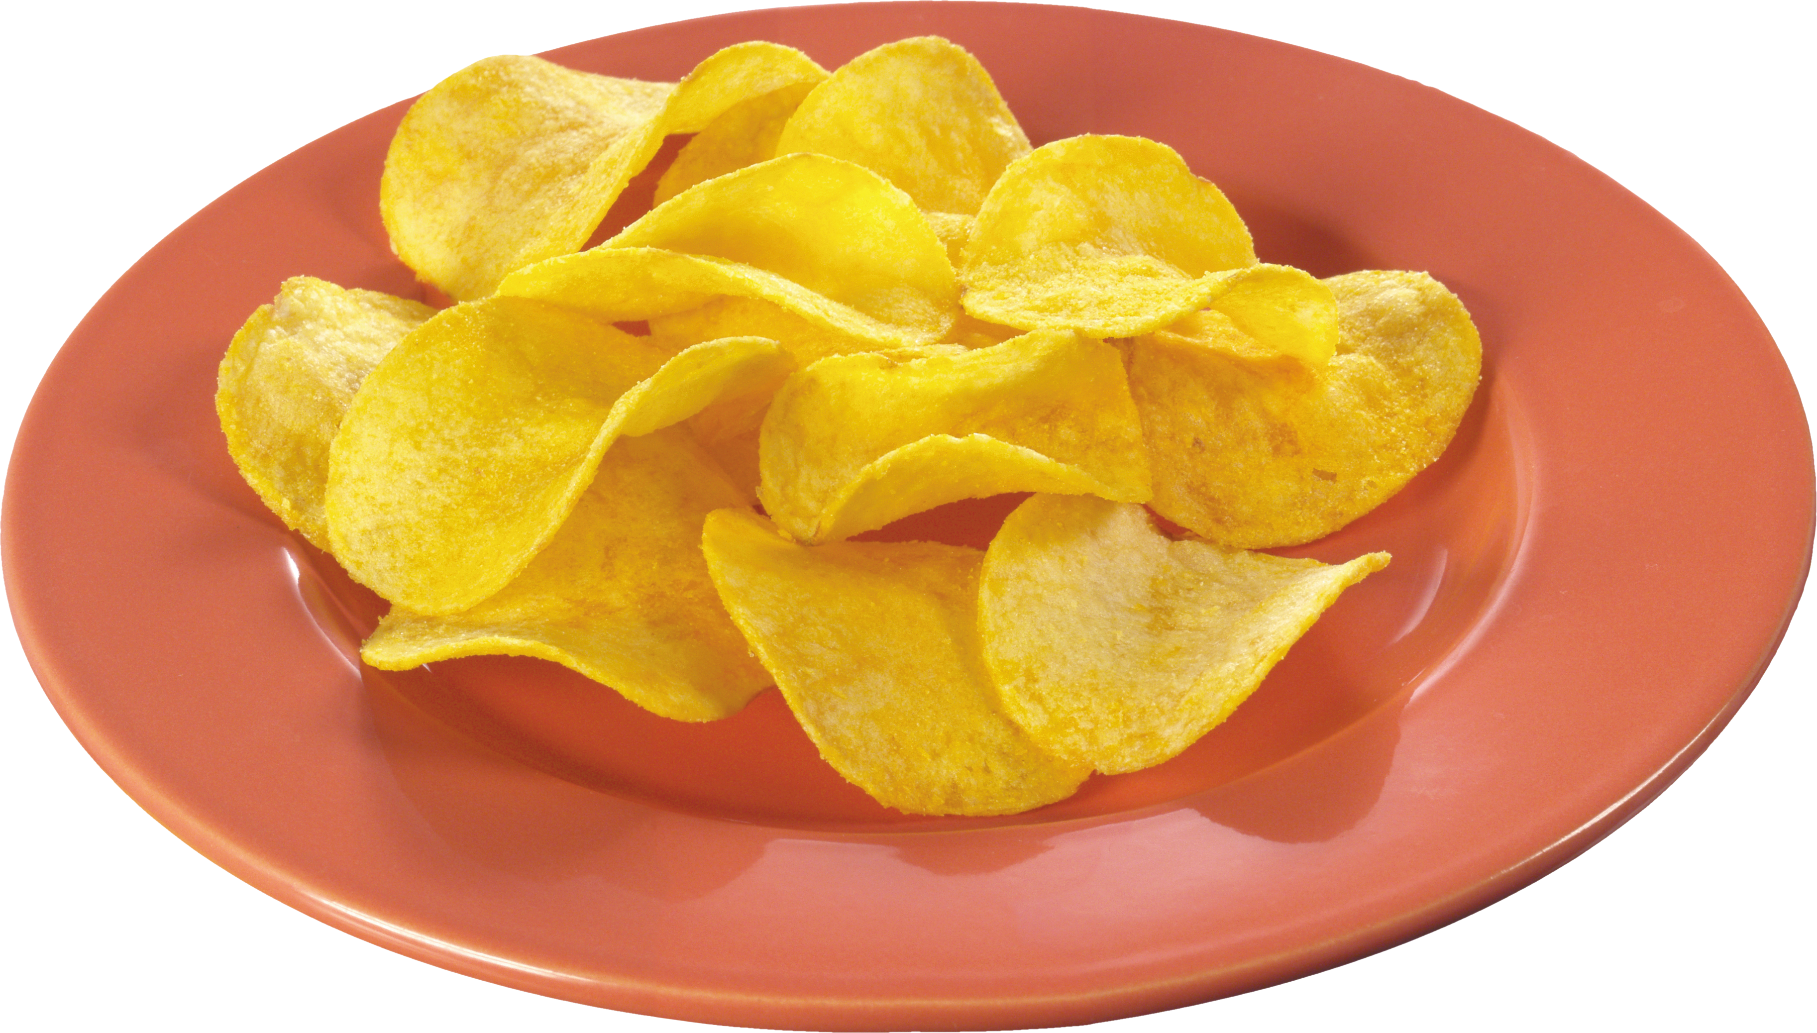
see website for M-in-W notes
DLS-website.com
compound angles
spirals
polygons
cow catcher

